Slide 1
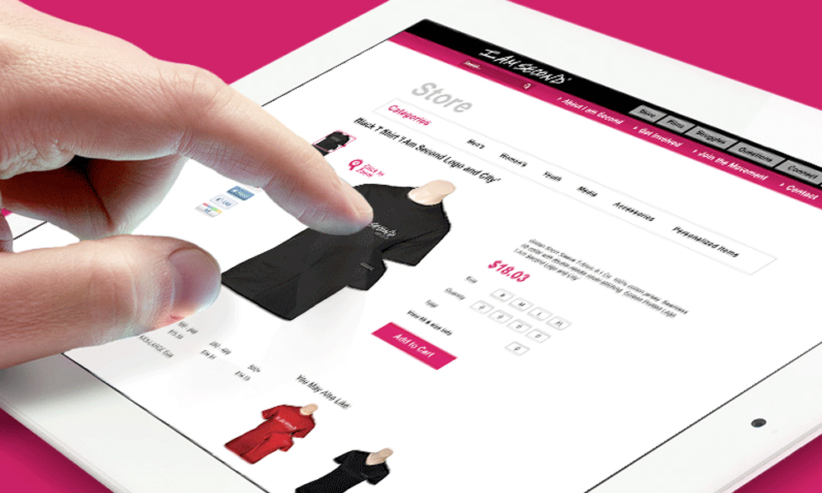
Mini Online Store
Khizra Naushad - 076
K.Shruthi - 105

Slide 2

Abstract
Shopping –It is something that we all love to do, undoubtedly we all have to buy things from time to time .Online store thus can save our time from driving to the store and wandering around stores .
This store contains a few categories Clothing, Groceries, Covid accessories .As per the users wish they can shop and add to cart .You can make payments through debit or credit cards although you have an option of cash on delivery.

Slide 3
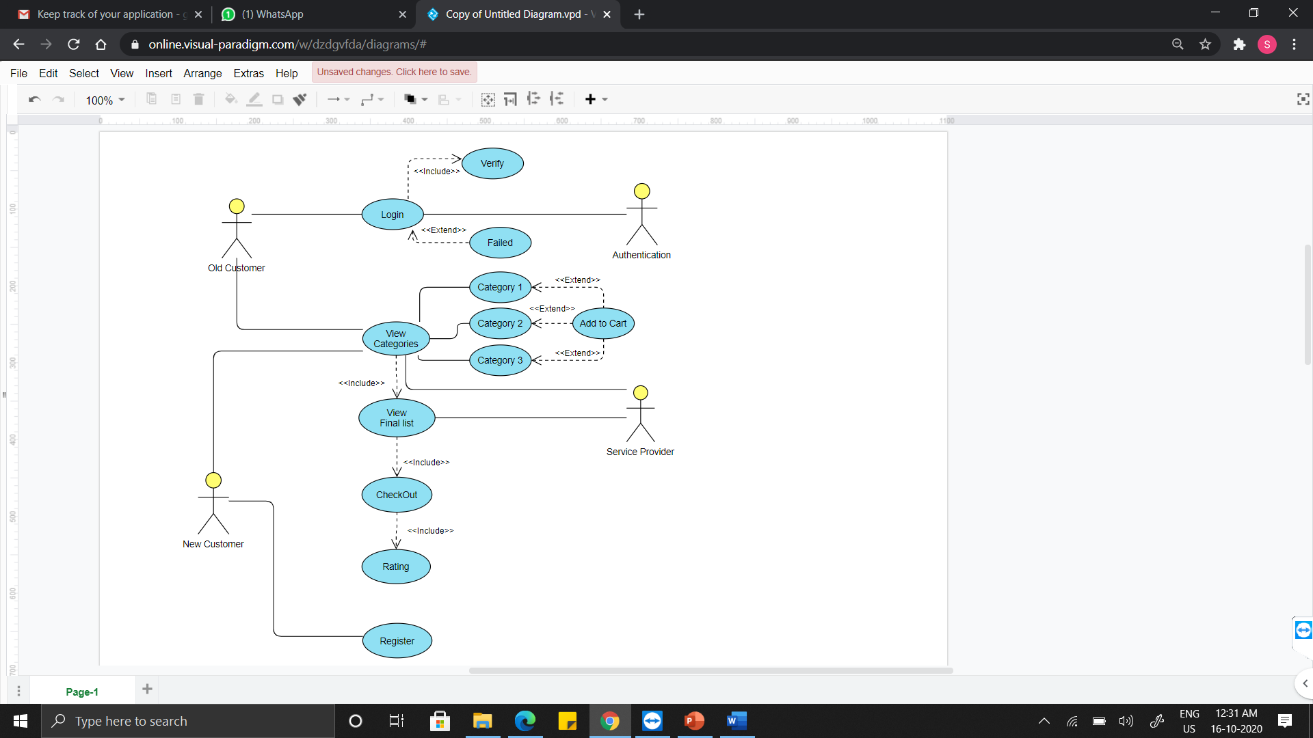
USE CASE DIAGRAM

Slide 4
TECHNOLOGY USED
SOFTWARE:
The software required to run this application is gcc complier along with the
source code.
Any computer which is compatible with gcc will be able to run this project.
HARDWARE:
The application is tested on Intel Core i3,
The Minimum requirements are:
● CPU: Intel Core i3 (6th gen)
● RAM: 6GB
● GPU: Intel HD 52

Slide 5
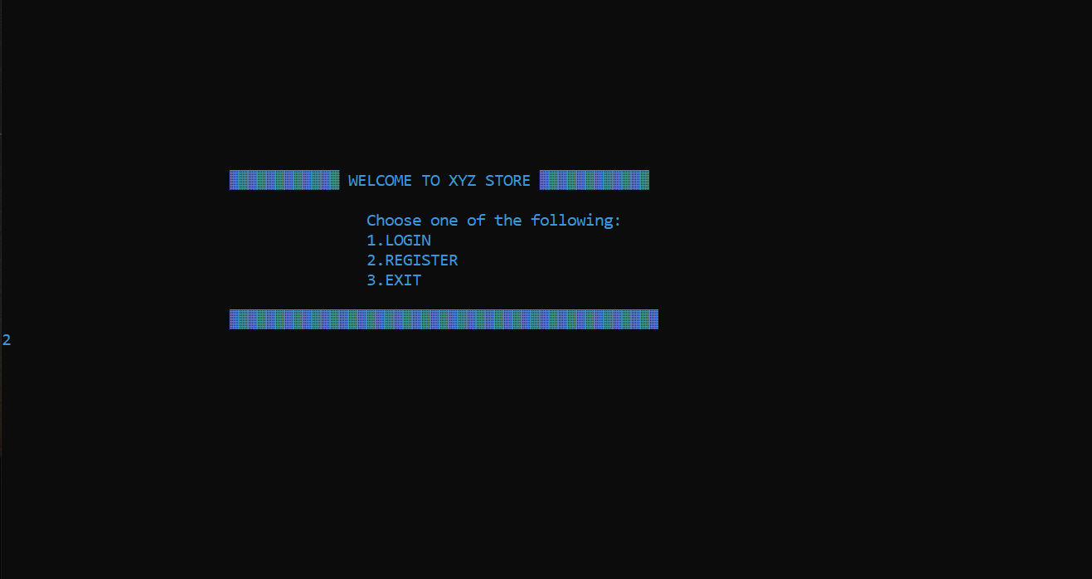
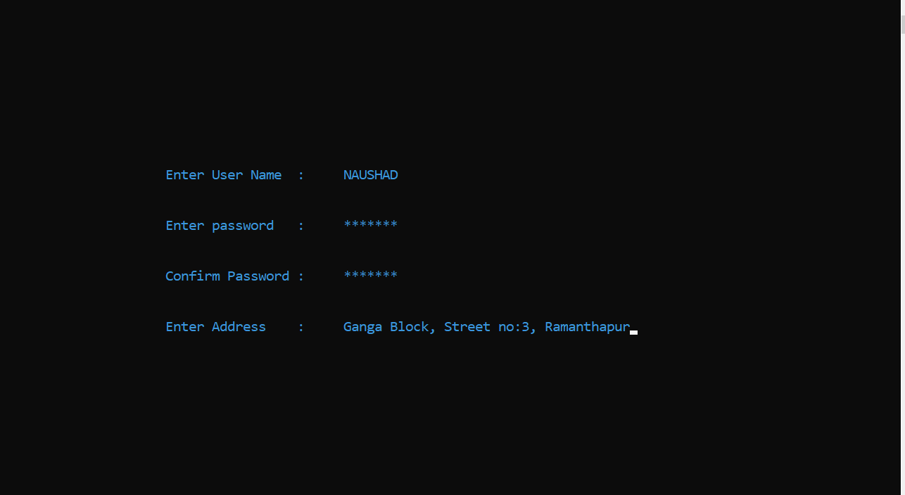
RESULTS

Slide 6
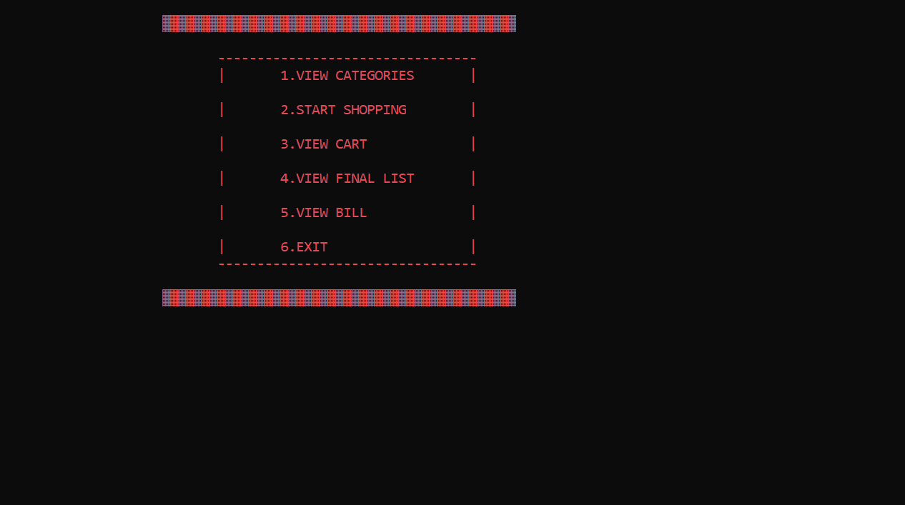
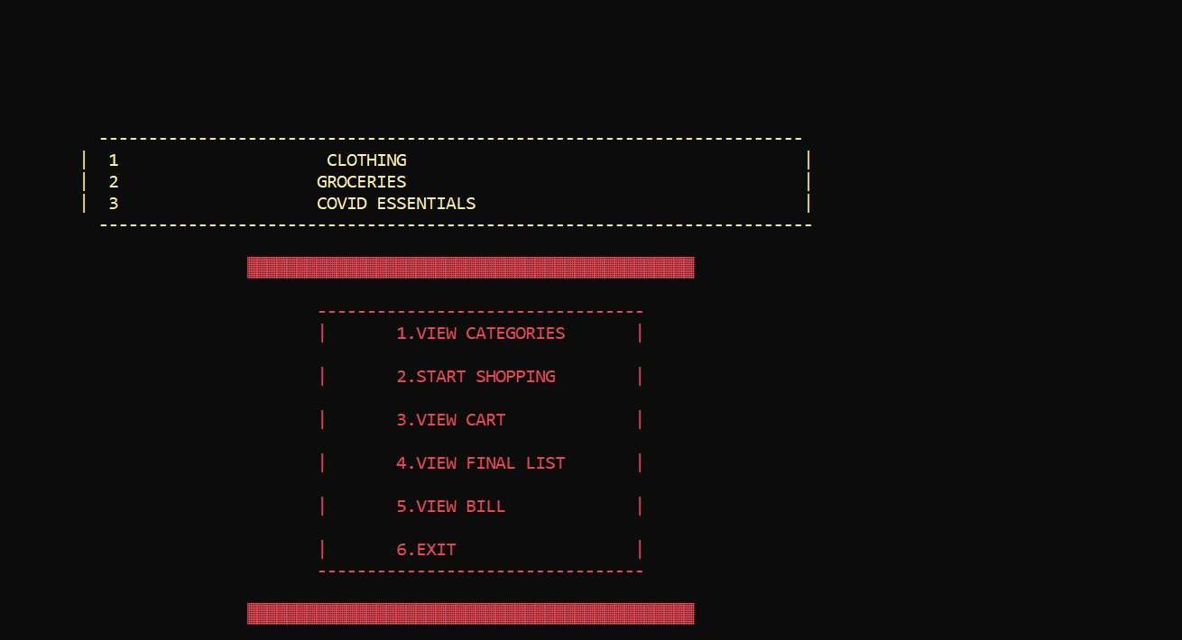

Slide 7
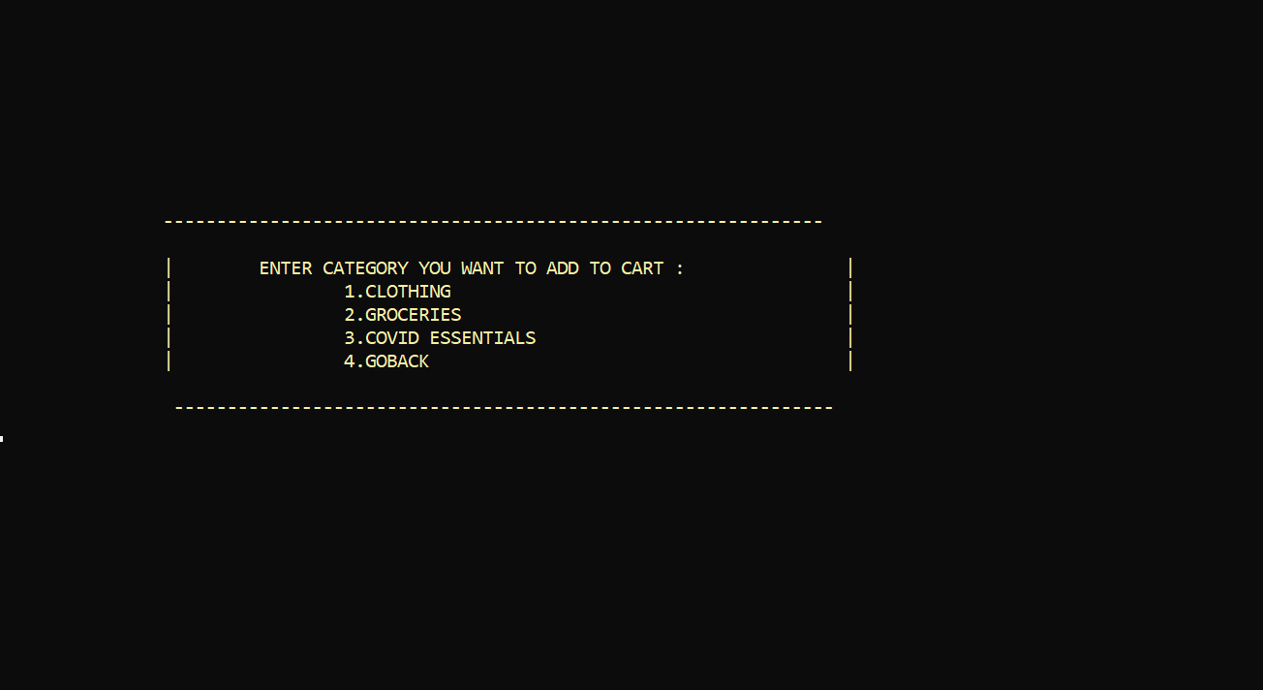
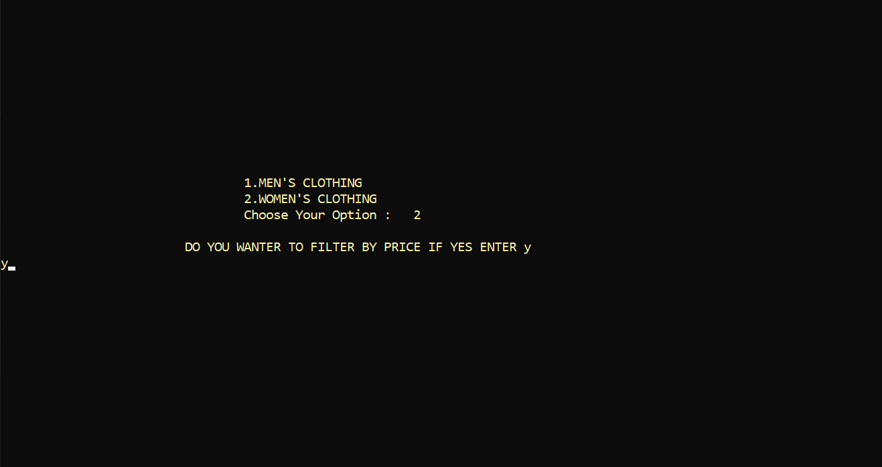

Slide 8
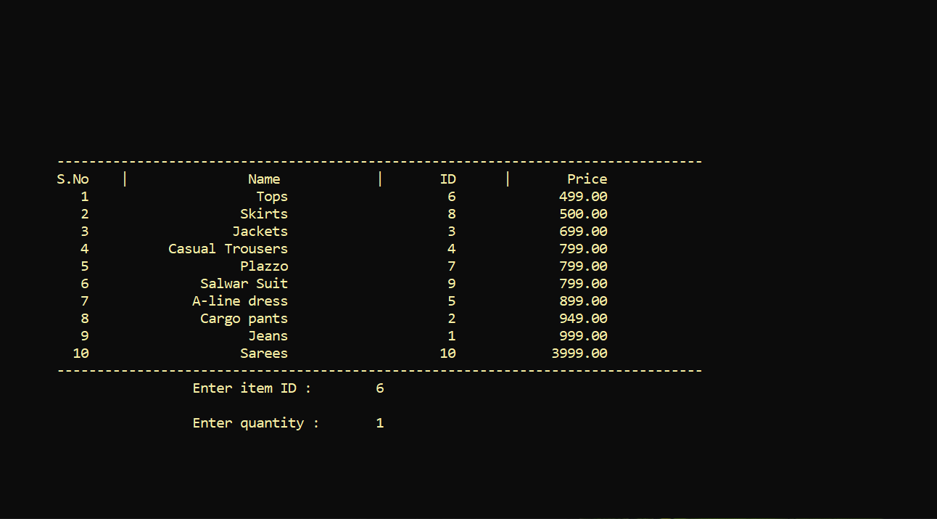
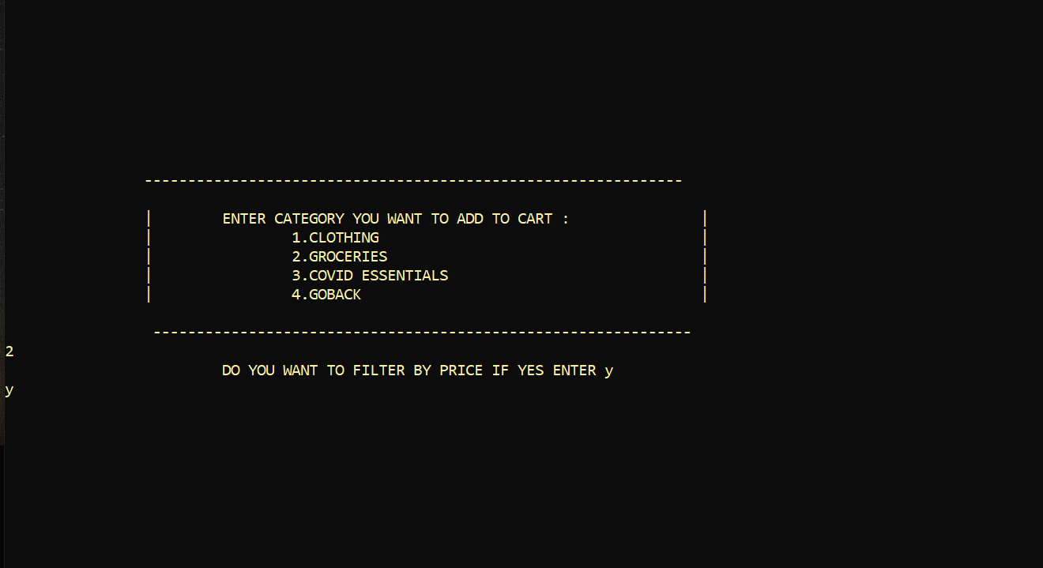

Slide 9
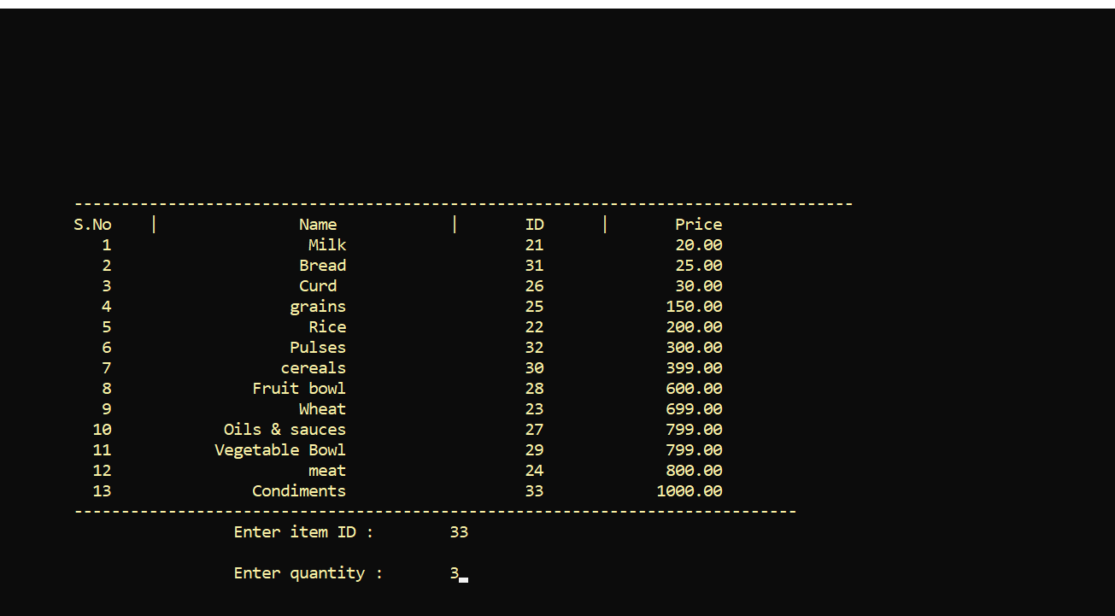
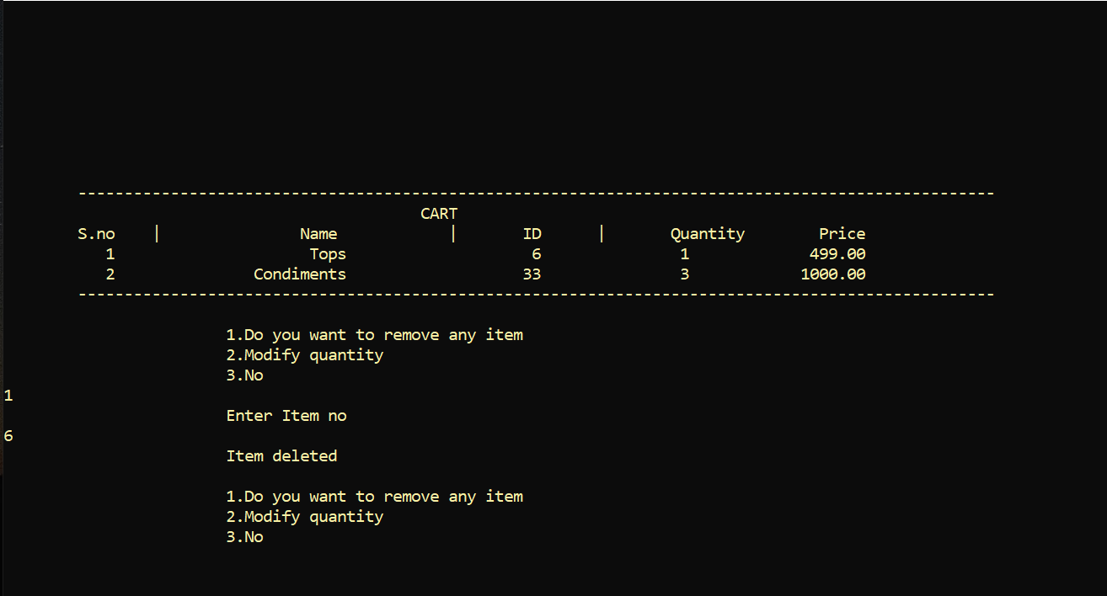

Slide 10

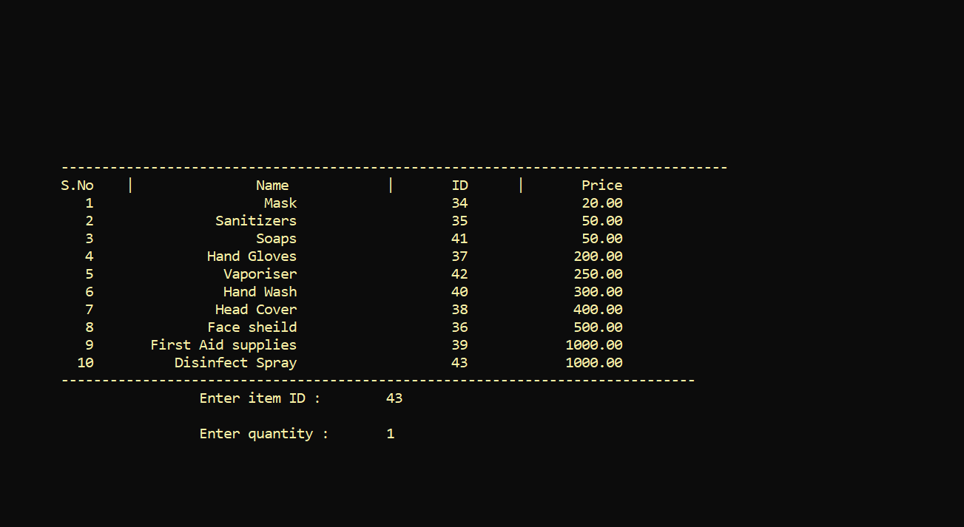

Slide 11
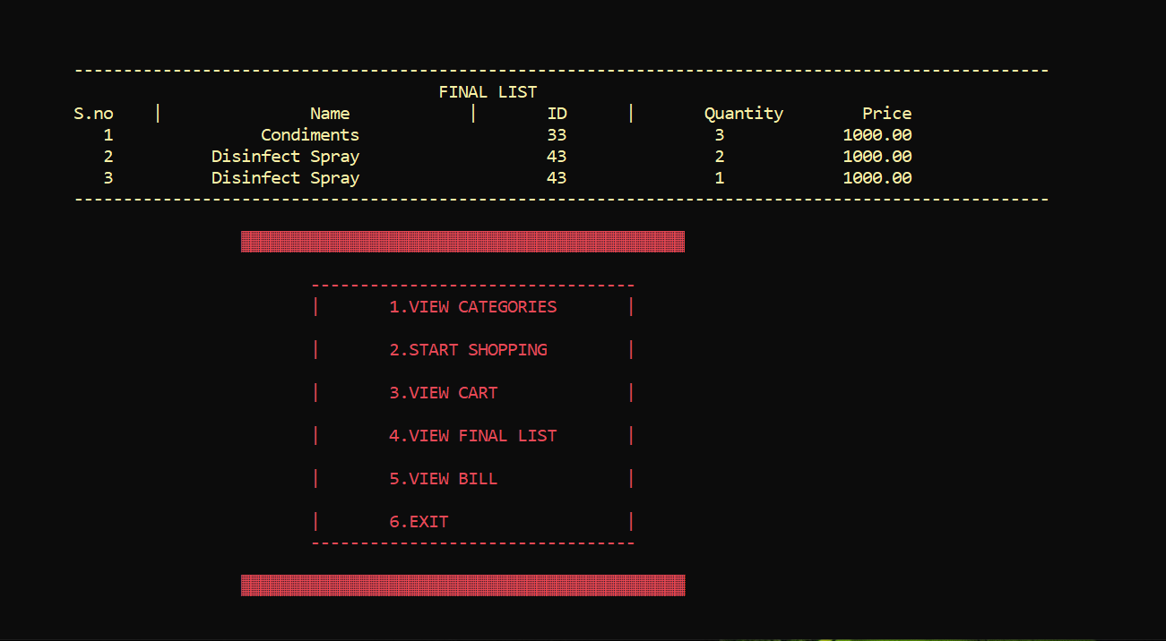
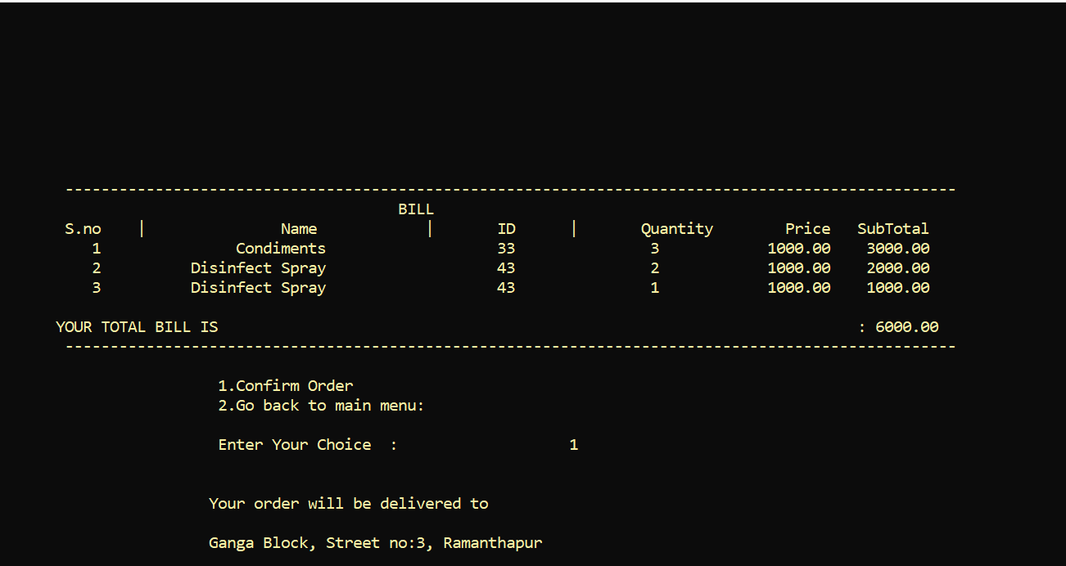

Slide 12
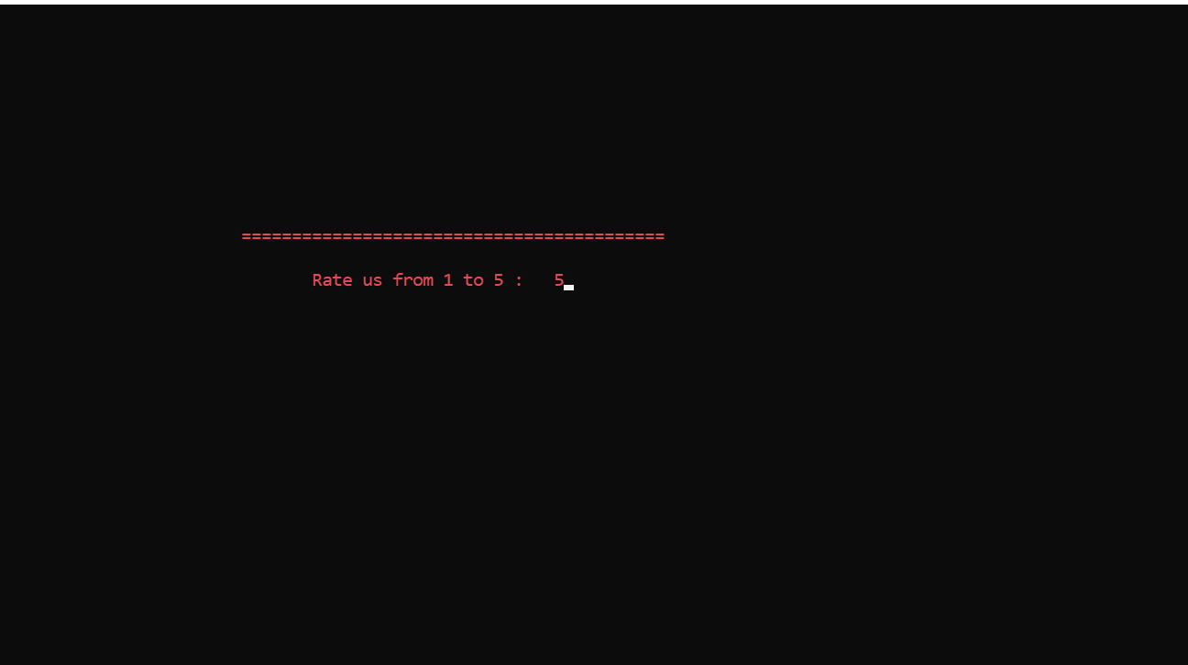
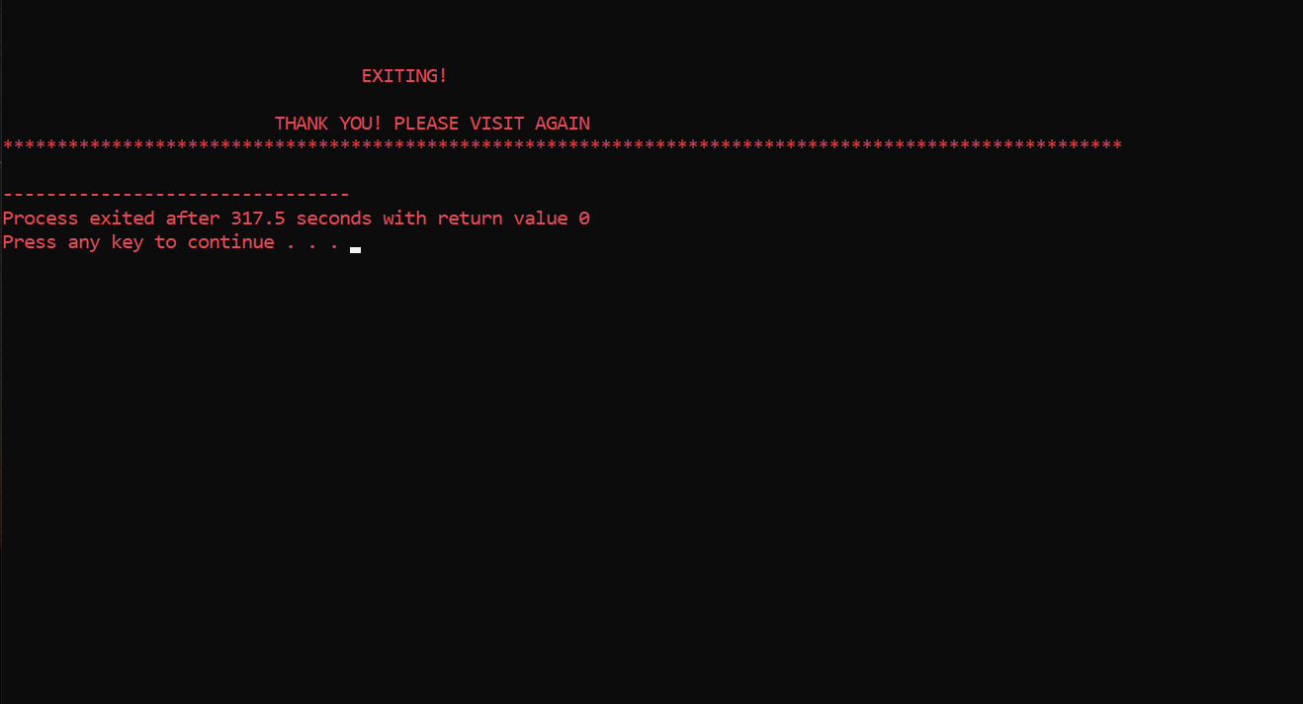

Slide 13
CONCLUSION AND FUTURE WORK
There is a scope for further development in our project to a great extend. A number of
features can be added to this system in future like providing
Adding images, taking comments.
Adding Online payment.
Sending OTP through twillo.
A few more graphics can be added to it

Slide 14

THANK YOU!

